Slide 1
应用现代化
演讲者姓名

Slide 2

上云之路
Migrate
Modernize
Containerize
+ cloud managed services
Existing
apps & services
.NET Framework
on-premises
Cloud
Infrastructure-
Ready
apps
Cloud
Optimized
apps
Rehost
Cloud-Native
apps
Rearchitect/Rebuild
On-Premises
Infrastructure Platform
IaaS
“Lift & shift”
No code changes
Containers
& PaaS
Minimal code changes
Microservices Architecture
& Serverless
Architected for the cloud
modernized/rewrite

Slide 3












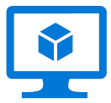









. Net 应用程序现代化的成熟度模型
Existing apps
.NET web apps (on-premises)
Cloud
Infrastructure-Ready
Cloud-Optimized
PaaS
Cloud-Native
PaaS for microservices and serverless
Monolithic or N-Tier
architectures
Monolithic or N-Tier
architectures
Monolithic or N-Tier
architectures
Microservices and serverless architectures
Relational Database
IaaS
(Infrastructure as a Service)
Managed services
VMs
PaaS for containerized microservices
+ Serverless computing
+ Managed services
+
Windows Containers
On-premises
Azure
Azure
Azure
Base Cloud Environment and cross-cutting concerns: Network, Hybrid-cloud, Identity/Auth, Cost control and Operations model
Migrate / Rehost
Modernize
Minimal code changes
Architected for the cloud, needs new code

Slide 4
议程
分析客户需求 15 分钟
设计解决方案 60 分钟
提出解决方案 30 分钟
总结 15 分钟
动手实验 120 分钟

Slide 5

摘要和学习目标
在此白板设计会话中，您与一个组组员合作，通过利用云服务设计一个解决方案，使遗留的本地应用程序和基础架构现代化。作为现代化工作的一部分，应用程序增强功能使用 Web 和移动服务的组合添加，所有这些服务都使用 Azure 活动目录进行保护。
在此白板设计课程结束时，您将能够为希望将服务从本地移动到云的组织设计现代化计划。

Slide 6
步骤 1: 查看客户案例
结果
分析客户需求
时间
15 分钟

Slide 7

客户情况
Contoso, Ltd.提供全方位的长期保险服务，以帮助投保不足的人。
他们正努力应对由于增长快于预期而超载的问题。
Notes:
Contoso Ltd. is a new company in a very old business. Founded in Auckland, New Zealand, in 2005, by senior life insurance executives, the ambitious new company provides a full range of long-term insurance services to help people who are underinsured.
Almost from the start, the company grew far faster than anticipated. An avalanche of business meant that the original processes created to manage policy documentation became overloaded. Employees struggled to cope, even as the headcount rose from five to 110 during the first year.

Slide 8

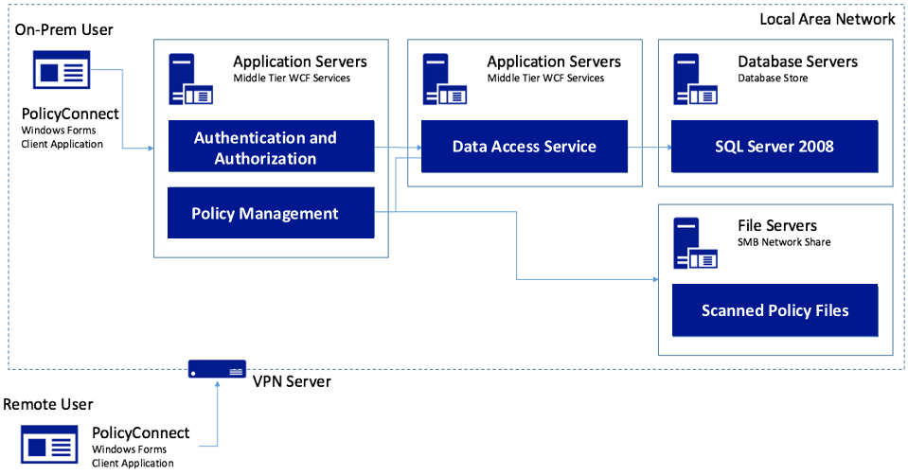
客户情况 - 2
Contoso, Ltd. 创建了一个名为PolicyConnect的自定义 Windows 窗体应用，供其员工管理保单持有人信息。
他们的数据存储在本地网络的 SQL Server 2008 数据库中，以及本地文件服务器上 。
Notes:
Contoso Ltd. implemented PolicyConnect, a custom Windows Forms application used by their staff to input key metadata that includes policy holder information such as insured amount, beneficiary, policy type, and any deductible and out of pocket requirements.
Contoso employees access this application which ultimately stores its data in a SQL Server 2008 database, and a file server on their local area network.

Slide 9



客户情况 - 3
员工依赖电子邮件作为文档管理任务的工作流引擎
希望不需要每次都是通过自定义开发才能够获得见解，可以通过低代码方式进行开发
希望可以直接通过Web和移动应用访问保单持有人信息系统而不需要通过VPN
Notes:
Contoso employees rely on email as a workflow engine relative to the document management tasks. They are using Office 365.
Executive leadership have frequent challenges in gauging productivity and throughput given the manual workflow—they feel that are blocked in quickly getting to the insights they need because each new question seems to need more custom development.
Wants to make their policy holder system available to its employees and brokers via web and mobile applications without requiring VPN, and store policies in cloud storage for retrieval via the new apps.
They would like to migrate their SQL Server based database to SQL Database

Slide 10




客户情况 - 4
我们希望确保我们的数据库不会负担过重，显示包含用户统计信息的仪表板，允许其他部门的非开发人员制作移动应用程序，以及通过保护应用程序机密来提高安全性。
你能帮我做到这一点吗？
Notes:
Want to ensure they employ best practices for mitigating the impact of repeated querying of the database
Looking to implement a scoreboard of sorts that tracks the most active users in a 24-hour period, as well as approximate the number of operations that user performed with the system in perpetuity
Want to make sure they have a streamlined way for internal departments to quickly build their own apps to automate time saving micro-processes without having to involve the PolicyConnect development team or ideally, even developers
Improve security by externalizing secrets such as connection strings from the web apps and APIs, and storing them in an encrypted location accessible only to authorized services
Contoso has multiple development teams and is concerned about duplication of effort and change management as they move more business logic to APIs. They also are considering opening a subset of APIs to a network of affiliated partners.

Slide 11






客户需求 - 5
实现架构现代化
移动应用
非开发人员也可以自己开发移动应用
改进应用敏感信息得管理
添加认知搜索
使用serverless API 技术
迁移 完全托管的 SQL database 服务
在解决方案中添加缓存支持

Slide 12

客户疑义
我们如何自动化我们的流程 ?
Microsoft Flow 是否 替代 Logic Apps?
真的有办法在云中安全的存储应用程序的 Secret ?
我们用到的 SQL 特性在 云里都有吗？
我们的API 数还在继续增长, 我们最关心如何 更好的管理好API.
想了解 如何正确 选择 .NET framework

Slide 13
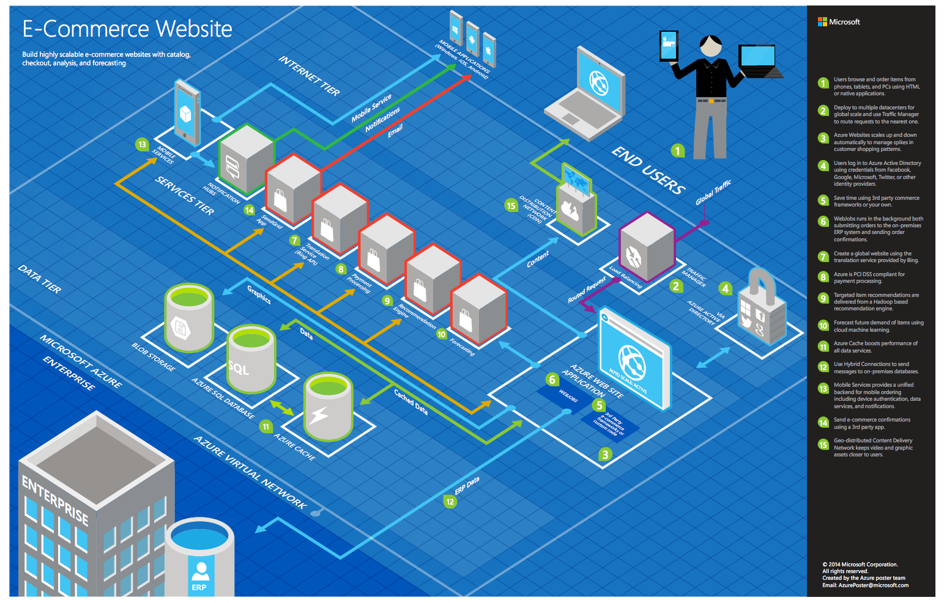
常见方案
Notes:
This is a diagram of a common architecture for this type of scenario, that you can draw inspiration from. You will find this diagram within the learner guide.

Slide 14
步骤 2: 设计解决方案
结果
设计解决方案，并准备以 15 分钟的向目标客户受众展示解决方案。
时间
60 分钟
业务需求 (10 分钟) | 回答指南中概述的问题，并在活动挂图上列出答案。
设计 (35 分钟) | 在允许的时间内，尽可能多的为声明需求设计解决方案。在活动挂图上显示解决方案。
准备 (15 分钟) | 确定在建议的解决方案中未满足的客户的需求. 确定解决方案的好处 确定您将如何回应客户的疑义. 准备给客户15分钟的口头演讲风格的演示文稿。
Notes:
在黑板上画图说明的非正式的讲演

Slide 15
步骤 3: 提出解决方案
结果
以 15 分钟的chalk-talk 形式为目标客户提供解决方案。
时间
30 分钟 (每个团队 15 分钟来展示和接收反馈）
方向
2个团队进行配对.
1个代表Microsoft团队，另一个团队是客户.
Microsoft团队向客户介绍了他们提出的解决方案.
客户从异议列表中提出异议之一.
Microsoft团队对此异议作出了回应.
客户团队向Microsoft团队提供反馈.

Slide 16
总结
结果
选出案例研究的首选解决方案。确定其他团队设计的解决方案。
时间
15 分钟

Slide 17

首选目标受众
Charlene Mathis, Contoso 公司总经理,
主要受众是业务和技术决策者。
通常，我们会与向首席信息官（CIO）汇报的基础架构经理，或与业务线（LOB）副总裁（VP），首席营销官（CMO）等应用程序赞助商进行报告，或者与那些代表向应用程序发起人报告的业务部门IT或开发人员。

Slide 18
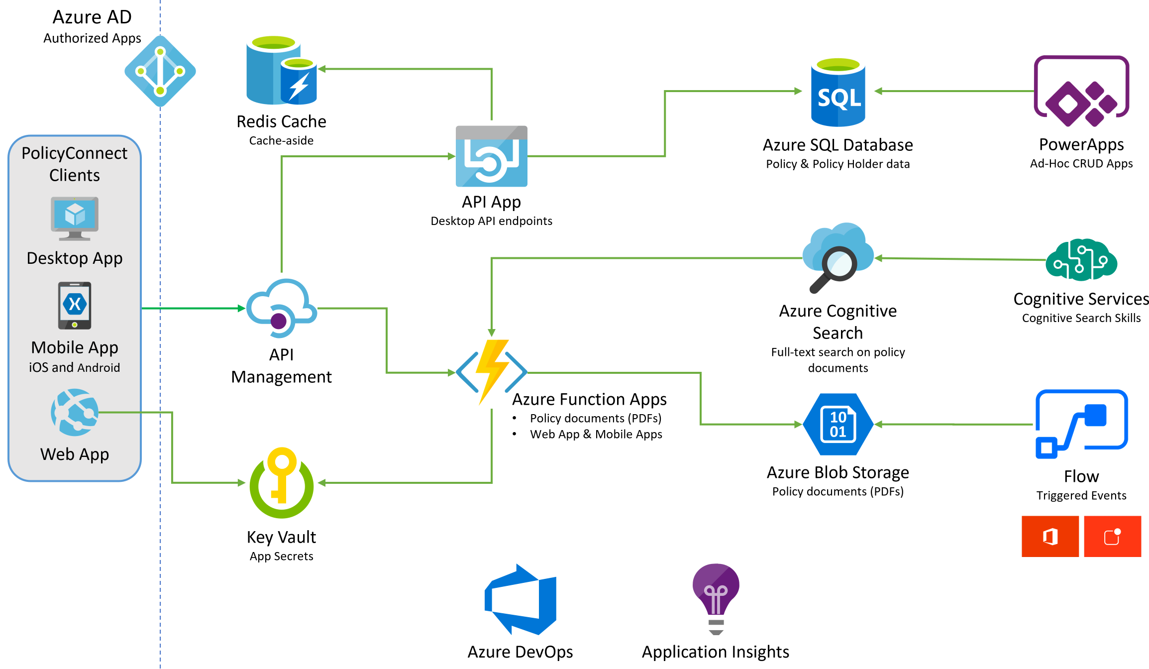
首选解决方案
Notes:
The solution begins with migrating Contoso's SQL Server 2008 R2 database to Azure SQL Database using the Azure Database Migration Service. After performing an assessment using the Data Migration Assistant, Contoso was able to determine that there were no compatibility issues or unsupported features to prevent them from migrating into a fully-managed SQL database service in Azure. Next, the web and API apps are migrated into Azure App Services. In addition, mobile apps, built for Android and iOS using Xamarin, are created to provide access to PolicyConnect. The website, hosted in a Web App, provides the user interface for browser-based clients, whereas the Xamarin Forms-based apps provide the UI to mobile devices. Both the mobile app and website rely on web services hosted in a Function App, which sits behind API Management. An API App is also deployed to host APIs for the legacy Windows Forms desktop application. Light-weight, serverless APIs are provided by Azure Functions and Azure Functions Proxies to provide access to the database and policy documents stored in Blob Storage. Azure API Management is used to create an API Store for development teams and affiliated partners. Sensitive configuration data, like connection strings, are stored in Key Vault and accessed from the APIs or Web App on demand so that these settings never live in their file system. The API App uses the Azure Redis Cache to implement the cache aside pattern, caching data as it is retrieved from SQL Database. A full-text cognitive search pipeline is used to index policy documents in Blob Storage. Cognitive Services are used to enable search index enrichment using cognitive skills in Azure Cognitive Search. PowerApps enable authorized business users to build mobile and web create, read, update, delete (CRUD) applications that interact with SQL Database and Azure Storage, while Microsoft Flow enables them to orchestrations between services such as Office 365 email and services for sending mobile notifications. These orchestrations can be used independently of PowerApps or invoked by PowerApps to provide additional logic. The solution uses user and application identities maintained in Azure AD.
该解决方案从使用 Azure 数据库迁移服务将 Contoso 的 SQL Server 2008 R2 数据库迁移到 Azure SQL 数据库开始。使用数据迁移助手执行评估后，Contoso 能够确定没有兼容性问题或不受支持的功能，以防止它们迁移到 Azure 中完全托管的 SQL 数据库服务。接下来，Web 和 API 应用将迁移到 Azure 应用服务中。此外，为使用 Xamarin 为 Android 和 iOS 构建的移动应用程序用于提供对策略连接的访问。托管在 Web App 中的网站为基于浏览器的客户端提供用户界面，而基于 Xamarin 窗体的应用向移动设备提供 UI。移动应用和网站都依赖于托管在函数应用中的 Web 服务，该应用程序位于 API 管理之后。API 应用还部署到旧版 Windows 窗体桌面应用程序的托管 API。轻量级、无服务器 API 由 Azure 函数和 Azure 函数代理提供，以提供对存储在 Blob 存储中的数据库和策略文档的访问。Azure API 管理用于为开发团队和附属合作伙伴创建 API 存储。敏感配置数据（如连接字符串）存储在密钥保管库中，并按需从 API 或 Web 应用进行访问，以便这些设置永远不会位于其文件系统中。API 应用使用 Azure Redis 缓存实现缓存一边模式，在从 SQL 数据库中检索数据时缓存数据。全文认知搜索管道用于在 Blob 存储中为策略文档编制索引。认知服务用于在 Azure 认知搜索中使用认知技能启用搜索索引丰富。PowerApps 允许授权业务用户构建与 SQL 数据库和 Azure 存储交互的移动和 Web 创建、读取、更新、删除 （CRUD） 应用程序，而 Microsoft Flow 则允许他们在 Office 365 电子邮件和服务（如 Office 365 电子邮件和服务）之间进行协调，以便发送移动通知。这些业务流程可以独立于 PowerApps 使用，也可以由 PowerApps 调用来提供其他逻辑。该解决方案使用 Azure AD 中维护的用户和应用程序标识。

Slide 19
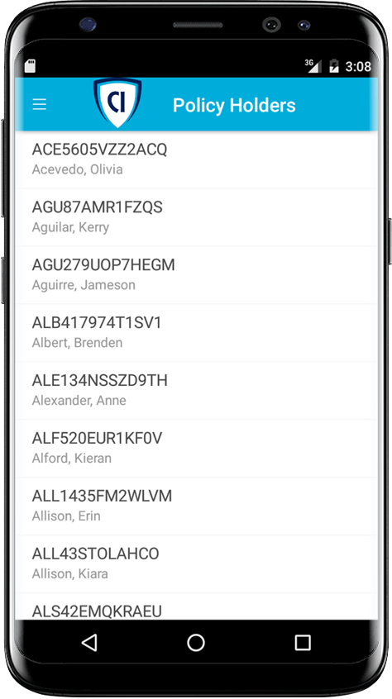



首选解决方案 - 2
移动 和 Web应用程序
使用 Xamarin 构建移动应用
使用一个 API 作为后端
使用Web App宿主 Web网站
使用 Azure Functions Proxies
Notes:
How should Contoso implement the PolicyConnect mobile app?
- Utilize Xamarin within Visual Studio
What Azure service would host the services supporting the mobile app backend? Would you suggest a Mobile App or an API App? Why?
- In this scenario, either one would work because API Apps and Mobile Apps expose the same functionality that Contoso needs to support the Web App and the APIs that are behind the Web App and the Xamarin mobile application.
What Azure service would host the web site?
- A Web App
What Azure service would provide a light weight, serverless API solution for retrieving policy documents from Azure blob storage?
- Azure Functions Proxies provide an easy way to create serverless APIs, providing a way to break large APIs into multiple function apps (as in a microservices architecture), while still presenting a single API surface for clients.

Slide 20
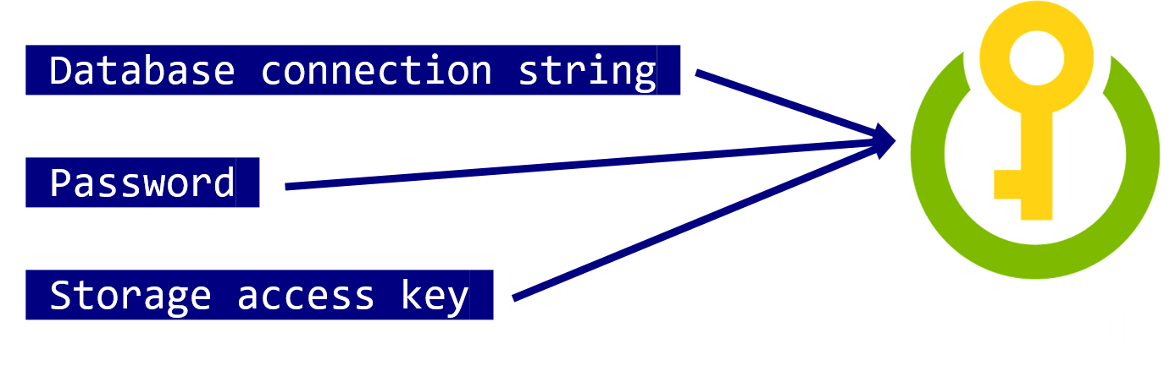
首选解决方案- 3
移动和Web 应用程序
使用 Key Vault 存储敏感的应用程序 secrets ，像数据库连接字符串
Notes:
How would you secure sensitive information used by the web site and APIs?
- Rather than storing sensitive application secrets like credentials and database connection strings in the web.config of the Web and API Apps, Contoso should use Key Vault to store these secrets

Slide 21
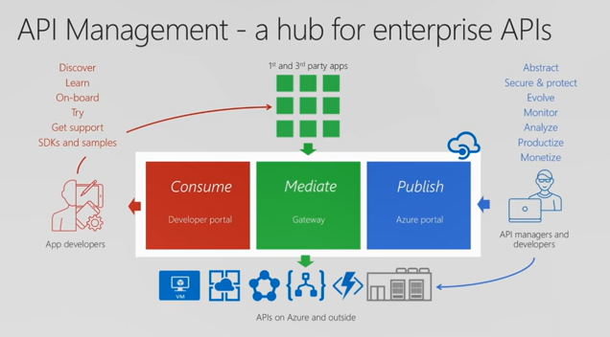

首选解决方案 - 4
API 管理
Contoso 现在应使用 Azure API 管理 来做POC 解决方案.
Azure API Management
Notes:
What recommendations can you make to help Contoso manage its API inventory as it grows in the future? Are there services in Azure that can provide a proof of concept *API Store* experience now and serve as path to development in the future?- Azure API Management has features to help Contoso quickly build and scale an API ecosystem and grow into the future. APIs can be organized into Product groups to provide organization and AAD integration comes out of the box. It will be relatively easy to develop new customer channels for affiliated partners and provide controlled discoverability and lifecycle management to development teams.

Slide 22
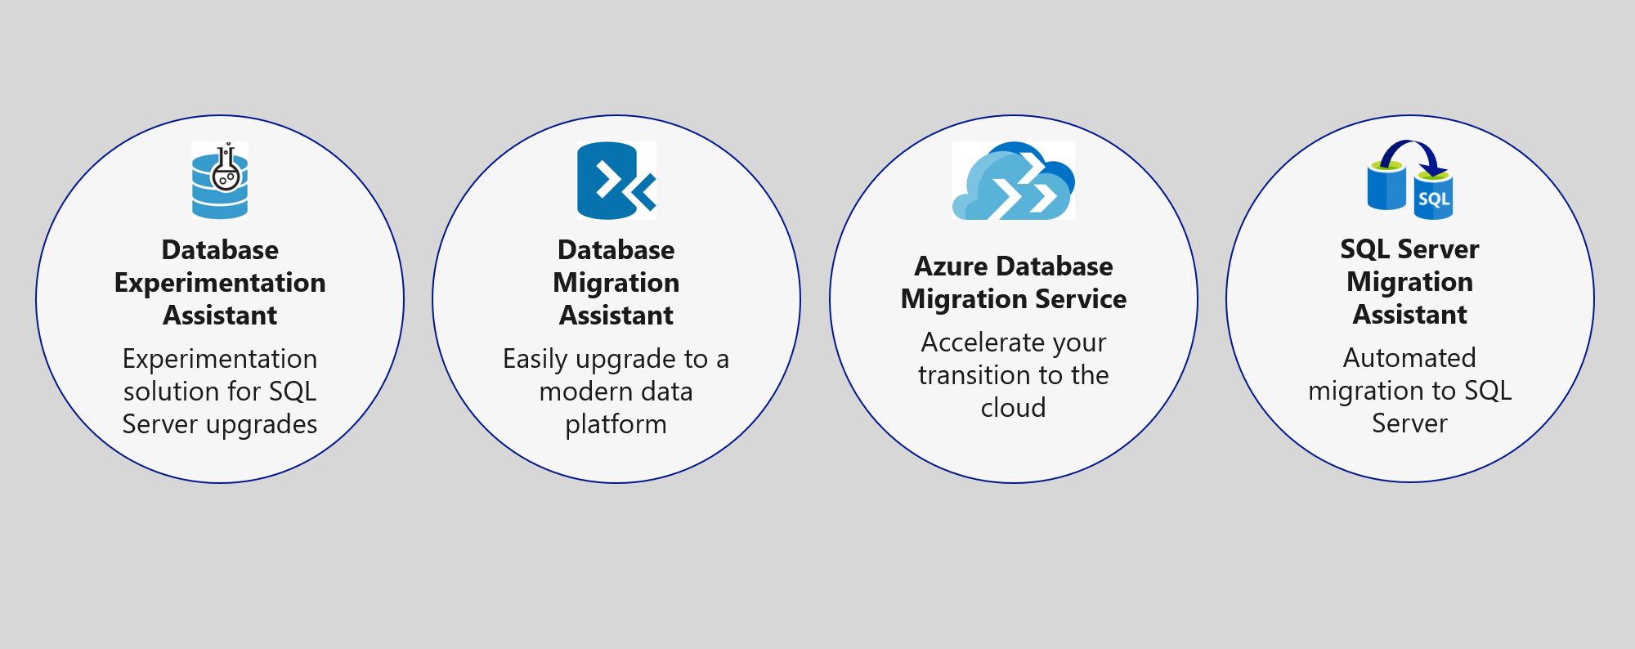
首选解决方案- 5
数据管理
使用 Database Migration Service 迁移数据库到Azure SQL

Slide 23
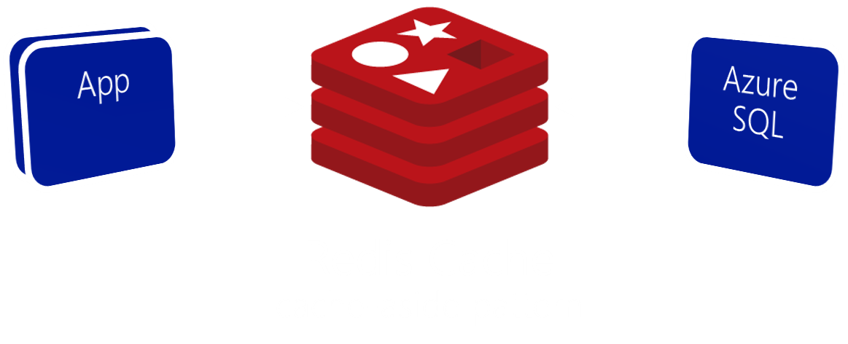
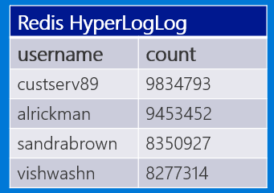
首选解决方案 - 6
数据管理
使用 Azure Redis Cache 降低数据库的负载 和实现积分榜
Scoreboard using HyperLogLog
Notes:
What patterns and services would you use to reduce load on the database? Implement the scoreboards?
- Use Azure Redis Cache and the cache-aside pattern.
- Check Azure Redis Cache is first on data requests. Return cached copy if exists, fetch from SQL Database if not, then save to Redis Cache.
- Scoreboards can also be implemented with Azure Redis Cache due to support for fast atomic incrementing of the values for any given string key (e.g., the key would be the username, the value the count). To reduce memory requirements for very large counts, use Redis’ HyperLogLog to store the counted value for each user key.
----------------------------------------------------------------------------------------
- In this approach, as data items are requested, the Azure Redis Cache is first checked to see if it exists there (if it is, then the cached copy is returned). Failing that, the application makes a request directly against SQL Database, but while returning the result to the client it also adds the data item into the Redis Cache.
- Scoreboards can be implemented effectively using Azure Redis Cache because of its support for fast atomic incrementing of the values for any given string key (e.g., the key would be the username, the value the count). To reduce memory requirements for very large counts (such as is possible collecting transaction counts per user in perpetuity), they could use Redis’ HyperLogLog to store the counted value for each user key. The HyperLogLog approximates the cardinality of a set the approximates the count of the number of unique items added (with an error rate less than 1%), and uses a fixed size of 12KB.

Slide 24
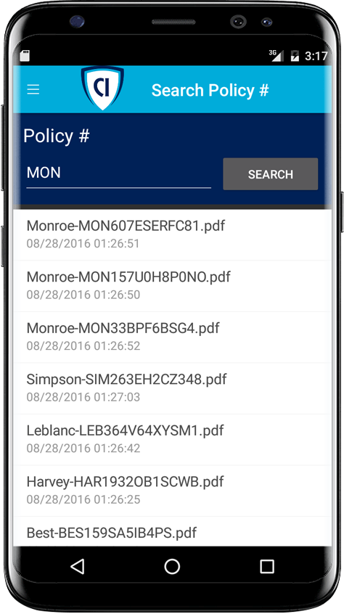

首选解决方案 - 7
搜索
使用 Azure 认知搜索启用策略文档的全文搜索.
Azure Cognitive Search + Indexer for Azure Storage blobs
Notes:
Given their requirements, how would you enable full text search on the stored policy documents?
- Use Azure Cognitive Search and the Indexer for Azure Storage blobs.
- For files stored in Azure Storage Blobs, this indexer will full-text index PDFs, Microsoft Office Documents (DOCX, DOC, XLSX, XLS, PPTX, PPT and MSG), HTML, XML, ZIP, EML, JSON, and plain text files. They could then use the Azure Cognitive Search .NET SDK from the API App to kick off searches.

Slide 25
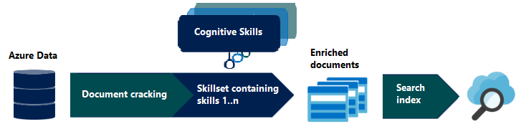
首选解决方案 - 8
搜索
使用认知搜索丰富搜索索引

Slide 26

首选解决方案 - 9
搜索
自定义认知技能
Azure Cognitive Search + Functions

Slide 27

首选解决方案 - 10
扩展性
业务用户能够使用 PowerApp 创建自己的内部移动应用。
他们可以使用 Microsoft Flow 创建 ad-hoc 自动化流程.
Notes:
How would you enable their business users to create their own internal mobile apps that help them streamline their processes without the time and resource investment required for full scale mobile apps?
- PowerApps would enable business users at Contoso to create their own web and mobile apps that support CRUD functionality against data in SQL DB and Azure Storage Blobs.
- Microsoft Flow, which integrates with PowerApps but can also be used stand-alone, would enable them to create automated processes in ad-hoc fashion. Business users could create these for their own use or share them back with the rest of the organization.

Slide 28

首选解决方案 – 11
扩展
业务用户可以通过 3 个简单的步骤 使用 Microsoft Flow 创建自动化电子邮件工作流:
使用 Office 365 创建一个高优先级邮件 启动一个新的流程.
使用 主题和来自邮件的发件人 发送一个推送通知动作.
用户 安装 Microsoft Flow 应用接收通知
Notes:
This could be implemented with Microsoft Flow.
The business user would login to Microsoft Flow and create a new flow. It would begin with Office 365, on new email, where the priority flag is set to High.
Then a Push notification – send a push notification action would follow that can use the subject and sender of the email in the subject of the notification.
The user would save this flow. To receive notifications, the user would need to install the Microsoft Flow app on her mobile device.

Slide 29


首选异议处理
我们如何自动化我们的流程 ?
Microsoft Flow 是否 替代 Logic Apps?
真的有办法在云中安全的存储应用程序的 Secret ?
我们用到的 SQL 特性在 云里都有吗？
我们的API 数还在继续增长, 我们最关心如何 更好的管理好API.
想了解 如何正确 选择 .NET framework
Notes:
* Microsoft Flow allows business users to automate their processes.
* Flow will not replace Logic Apps. Logic Apps represent an “advanced” version of Microsoft Flow, providing support for more developer centric tasks, such as integrating API Apps as custom actions, whereas Flow only provides pre-built actions.
* Azure Key Vault provides a mechanism to store secrets encrypted and securely stored within the confines of specialized hardware called Hardware Security Modules (HSM). * A proof of concept that demonstrates the capabilities of Azure API Management can be put together quickly and can easily be scaled up to create the API Store experience Contoso is looking for.
* It is likely that a feature that was previously built into SQL Server and used from applications directly now runs external to Azure SQL Database in the form of a separate Azure service. Examples include:
Linked servers- are not supported by SQL Server, but cross database read-only querying is possible using elastic database query.
Database Mail- which was used to send email directly from SQL Server is not supported, but there are multiple alternatives (such as using Office 365 and SendGrid) that applications can use to send emails.
SQL Server Agent Jobs- these background processes can usually be migrated to a Web Job (running within an App Service), Azure Functions, or to Cloud Service Worker Role.
Service Broker- numerous alternative messaging options exist in Azure, including Azure Storage Queues and Azure Service Bus Brokered Messaging.

Slide 30
客户评价
“Microsoft has done a brilliant job with the technology they have put into the cloud. Our Azure-hosted applications are modifiable, interoperable, and secure. We could not be happier running PolicyConnect on Azure.”
Charlene Mathis, General Manager, Contoso, Ltd.

